Slide 1
moose for dcs world detection & task dispatching
ALPHA RELEASE
based on a
Concept created by
mechanist (Gábor)
and in joint development with with moose framework community

Slide 2
DEMO

Slide 3
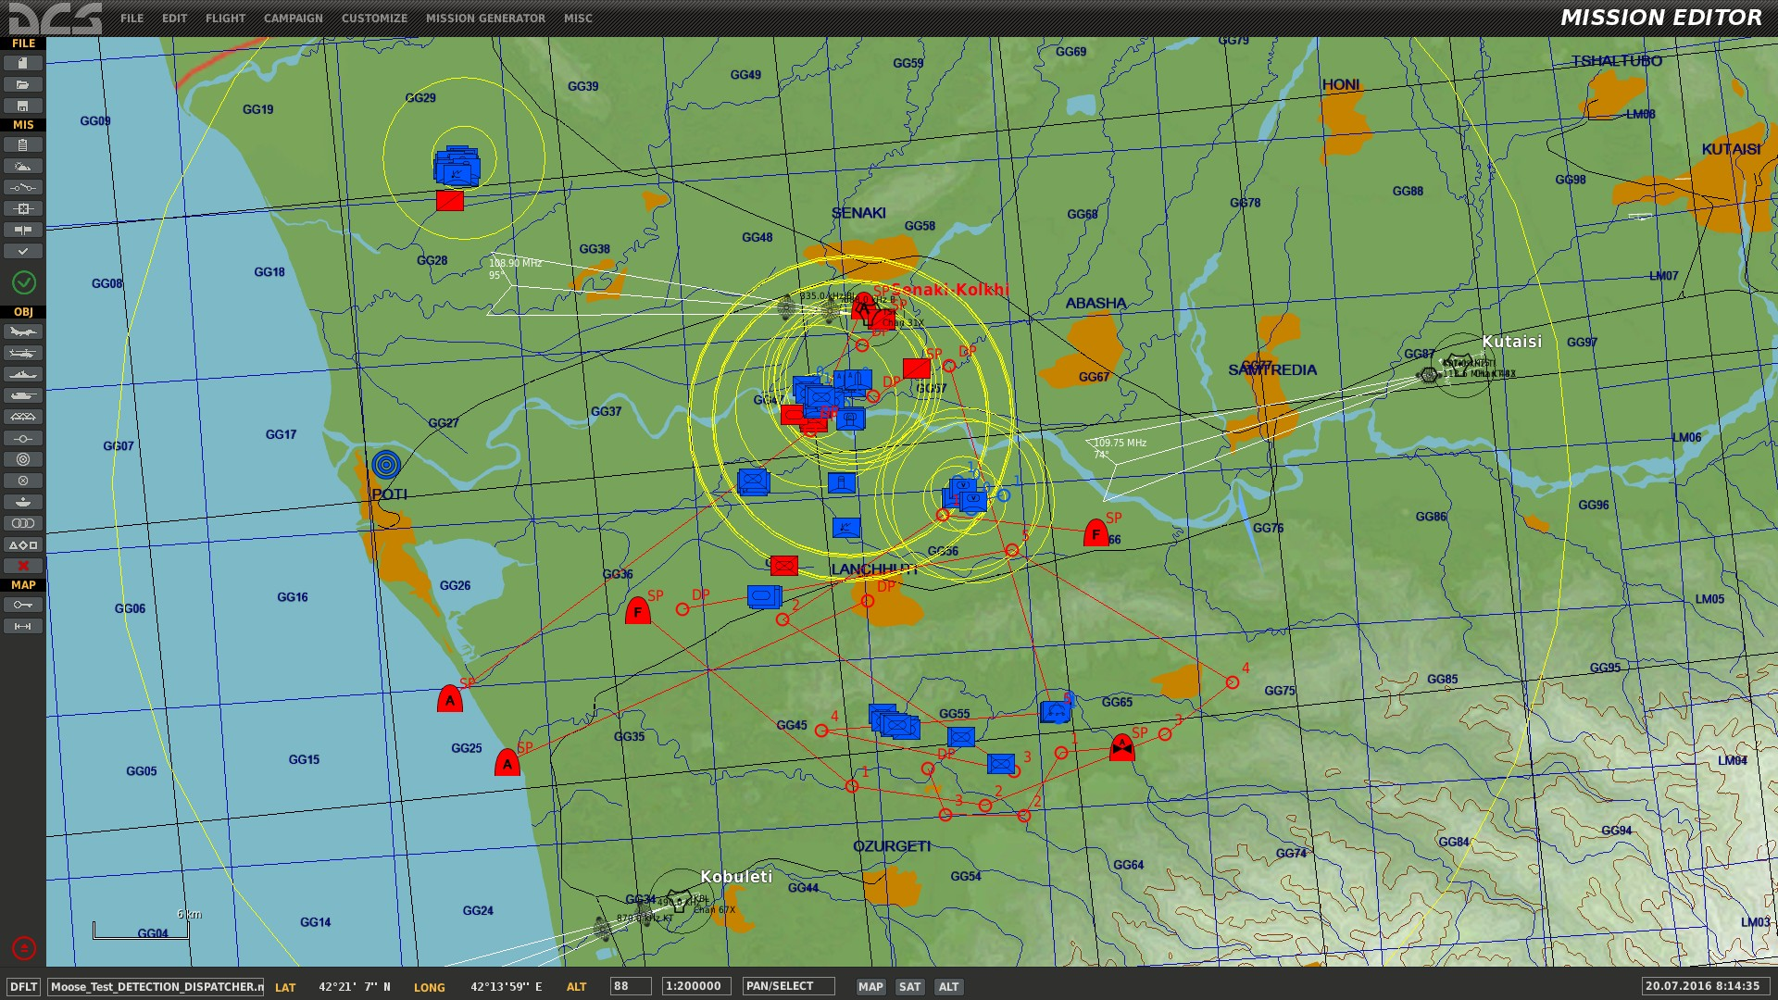
battle scene overview
1
Red against blue
1
2
Red ground FACs detecting blue targets
4
3
Red AFACs detecting blue targets
2
4
3 red attack GROUPS
3
4

Slide 4
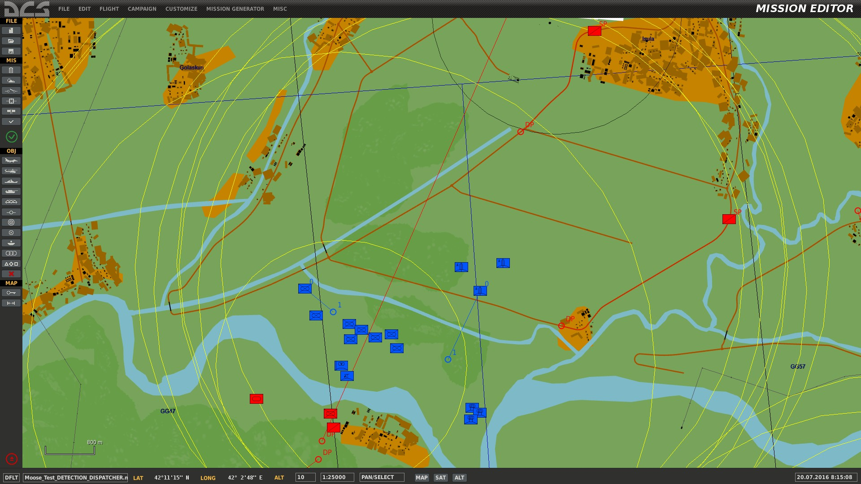
battle scene overview
1
Red ground FACs detecting blue targets
2
Friendlies are nearby the areas.
3
The blue forces are spread out and are of different unit types.
1
3
5
4
There are SAMs with SRs and TRs (HAWKS).
4
5
There are blue SAMs with IR capability.
5

Slide 5
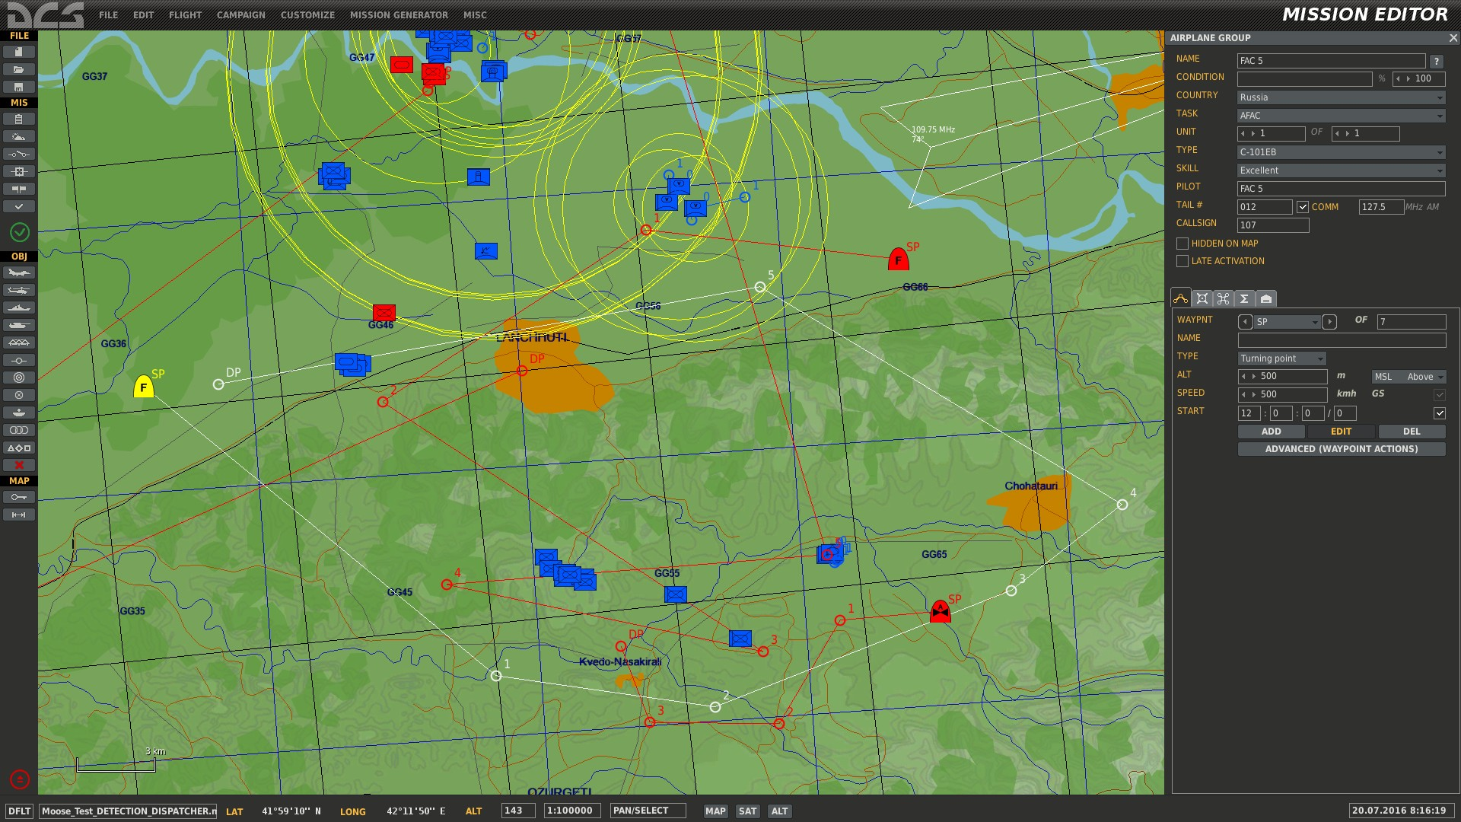
battle scene overview
1
Red airborne AFACs detecting blue targets
2
There are blue forces without friendlies nearby.
2
1

Slide 6
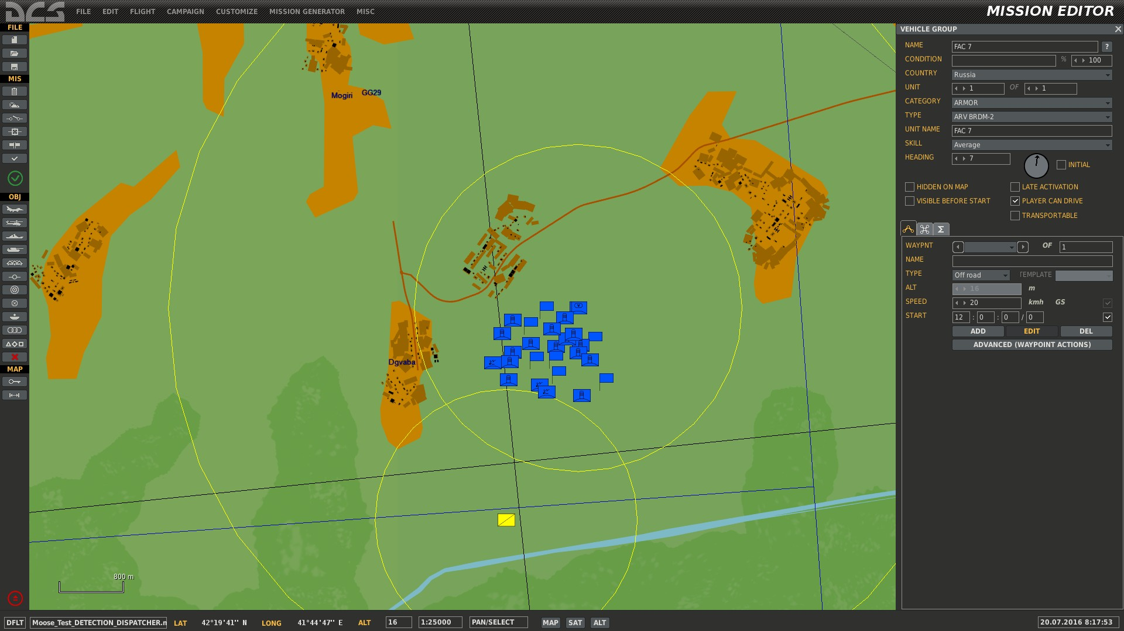
battle scene overview
1
A large PATRIOT battery is located in teh north.
2
A red FAC is detecting the area.
1
2

Slide 7
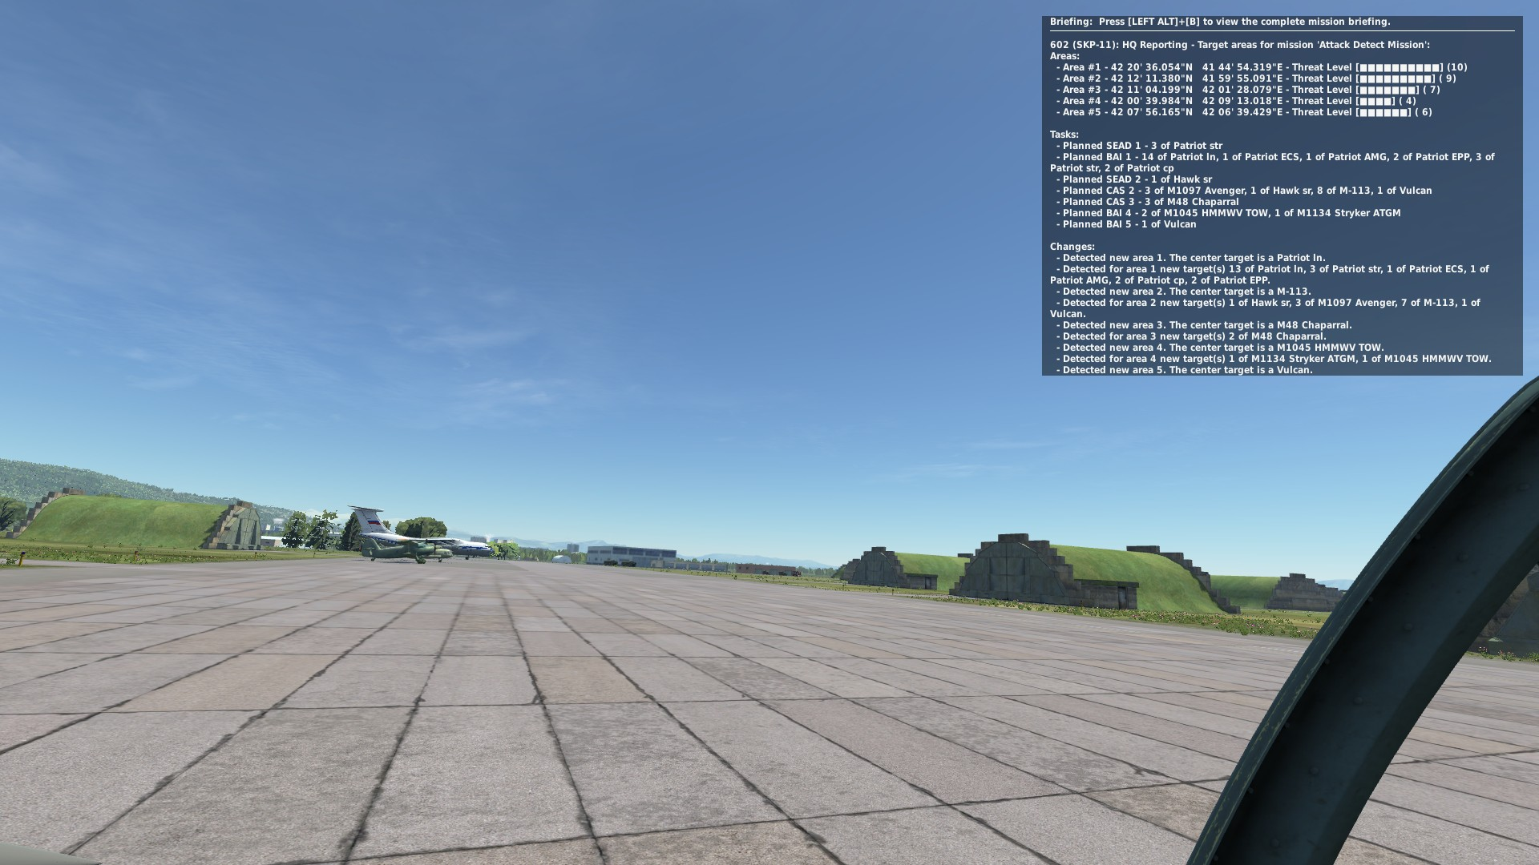
groups will receive taskings from hq
1
The Head Quarters (HQ) reporting tasks
2
We joined GROUP “Attack Theta” in an SU-25T to observe the tasking orders sequence.
1
2

Slide 8
each area is assigned a threat level
10
Long Range SAMs with Search and Tracking Radars.
9
Medium Range SAMs with Search and Tracking Radars.
8
Short Range SAMs with Search and Tracking Radars.
7
Short Range SAMs and MANPADS with Infrared Missiles.
6
Anti Aircraft Artillery
5
Modern Battle Tanks.
4
Battle Tanks and Infantry Vehicles with ATGM.
3
Battle Tanks and Infantry Vehicles without ATGM.
2
Old Tanks and APCs.
1
Infantry.

Slide 9
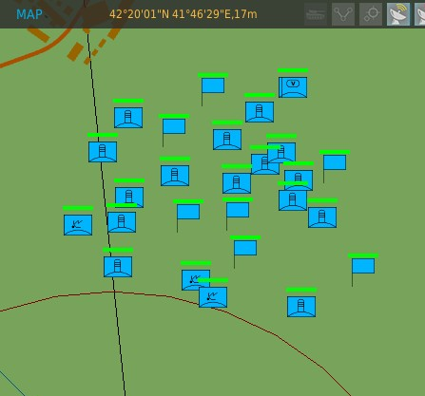
each area is reported coordinates
1
1
Each Area is reported with Latitude and Longitude coordinates

Slide 10
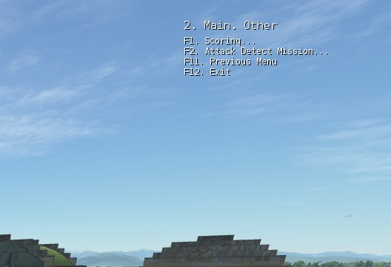
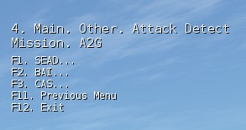
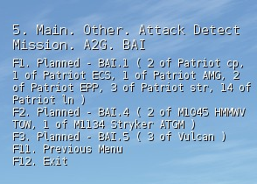
A tasking menu is created at each detection report
1
A new Tasking is created at each detection scan.
4
2
The Tasking Menu is located under “F10. Other” menu items.
3
3
Multiple MISSIONS that mayb be defined, have each their own Tasking Menu.
4
Optionally a SCORING can be added at each MISSION, which will account hits, kills, tasking and mission achievement scores.
5
5
Multiple task types are listed, going through the Menu. After selection of a task type, each task is listed.
6
As the MOOSE framework will evolve, more task types will be added ( CSAR, Transport, JTAC ) …

Slide 11
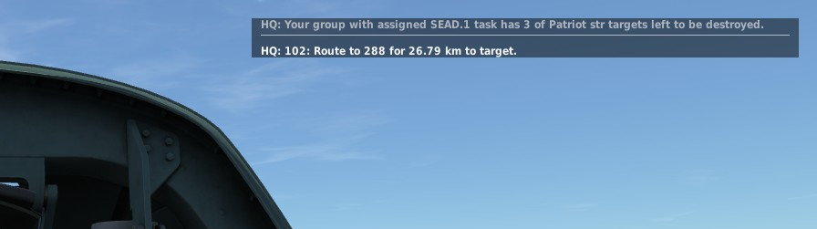
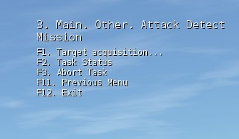
a selected task moves the group in assigned mode…
1
Once a target has been selected, the GROUP you are flying for goes in “ASSIGNED MODE”.
1
2
The tasking menu has changed in assigned mode. Relevant Task Menu options are displayed for the specific Task you selected.
3
2
3
You will receive specific task directions and target goal achievements. Status messages are also displayed.

Slide 12
WRAP up

Slide 13
consult the online documentation
All class and API descriptions on the MOOSE GITHUB pages.
There are online training videos available on my YOUTUBE CHANNEL.
The documentation explains:
How to use MOOSE and install it in your mission.
The directory structure of the MOOSE pack.
Classes are embedded in lua “modules”. Eg. the zone classes are collected in the lua module Zone.
A CLASS in the lua documentation is sometimes referenced by Module#CLASS.
The Module is sometimes not given, so #CLASS references to a class within the current module. All these references are clickable, so within the documentation, it is possible to move back and forth through the explanations.

Slide 14
Training missions
Each of the classes have Example Test Missions!
Find in the MOOSE pack or on GITHUB the relevant directories:
Moose_Test_DETECTION
Moose_Test_DETECTION_DISPATCHER
… (more will be added later).
Each of these directories contain:
A DCS World .MIZ file containing an executable mission.
The .LUA file containing the example code using the zone class (and other classes).

Slide 15
HOPE YOU FOUND THIS INTERESTING
You can reach me on SKYPE with the ID: FlightControl_Skype
Or, join the SLACK.COM development community at
https://flightcontrol.slack.com/messages/moose/

